Slide 1
Tuples ( ) and Sets{ }: Creating Tuples
In mathematics, a tuple is a finite ordered list (sequence) of elements. A tuple is defined as a data structure that comprises an ordered, finite sequence of immutable, heterogeneous elements that are of fixed sizes.
A tuple is a finite ordered list of values of possibly different types which is used to bundle related values together without having to create a specific type to hold them.
Tuples are immutable
Once a tuple is created, you cannot change its values. A tuple is defined by putting a comma-separated list of values inside parentheses ( ).
Each value inside a tuple is called an item.

Slide 2
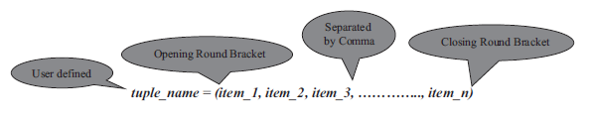
syntax for creating a tuple is
>>> internet = ("cern", "timbernerslee", "www", 1980)
>>> type(internet)
<class 'tuple'>
>>> f1 = "ferrari", "redbull", "mercedes", "williams", "renault"
>>> f1
('ferrari', 'redbull', 'mercedes', 'williams', 'renault')
>>> type(f1)
<class 'tuple'>

Slide 3
Empty and nested tuple
You can create an empty tuple without any values. The syntax is,
tuple_name = ()
You can store any item of type string, number, object, another variable, and even another tuple itself. You can have a mix of different
types of items in tuples, and they need not be homogeneous.
>>> air_force = ("f15", "f22a", "f35a")
>>> fighter_jets = (1988, 2005, 2016, air_force)
>>> fighter_jets
(1988, 2005, 2016, ('f15', 'f22a', 'f35a'))

Slide 4
Basic Tuple Operations
>>> tuple_1 = (2, 0, 1, 4)
>>> tuple_2 = (2, 0, 1, 9)
>>> tuple_1 + tuple_2
(2, 0, 1, 4, 2, 0, 1, 9)
>>> tuple_1 * 3
(2, 0, 1, 4, 2, 0, 1, 4, 2, 0, 1, 4)
>>> tuple_1 == tuple_2
False

Slide 5
Basic Tuple Operations
>>> tuple_items = (1, 9, 8, 8)
>>> 1 in tuple_items
True
>>> 25 in tuple_items
False
>>> tuple_1 = (9, 8, 7)
>>> tuple_2 = (9, 1, 1)
>>> tuple_1 > tuple_2
True
>>> tuple_1 != tuple_2
True

Slide 6
The tuple() Function
The built-in tuple() function is used to create a tuple. The syntax for the tuple() function is,
tuple([sequence])
where the sequence can be a number, string or tuple itself.
>>> norse = "vikings"
>>> string_to_tuple = tuple(norse)
>>> string_to_tuple
>>> zeus = ["g", "o", "d", "o", "f", "s", "k", "y"]
>>> list_to_tuple = tuple(zeus)
>>> list_to_tuple
('g', 'o', 'd', 'o', 'f', 's', 'k', 'y')
>>> string_to_tuple + "scandinavia"
>>> string_to_tuple + tuple("scandinavia")
('v', 'i', 'k', 'i', 'n', 'g', 's', 's', 'c', 'a', 'n', 'd', 'i', 'n', 'a', 'v', 'i', 'a')

Slide 7
>>> letters = ("a", "b", "c")
>>> numbers = (1, 2, 3)
>>> nested_tuples = (letters, numbers)
>>> nested_tuples
(('a', 'b', 'c'), (1, 2, 3))
>>> tuple("wolverine")
('w', 'o', 'l', 'v', 'e', 'r', 'i', 'n', 'e')

Slide 8
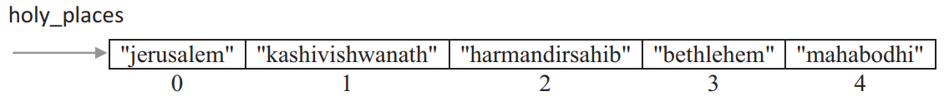
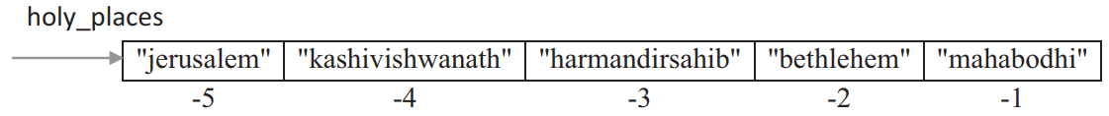
Indexing and Slicing in Tuples
The syntax for accessing an item in a tuple is, tuple_name[index]
where index should always be an integer value and indicates the item to be selected.
>>> holy_places = ("jerusalem", "kashivishwanath", "harmandirsahib", "bethlehem", "mahabodhi")
>>> holy_places
>>> holy_places[0]
>>> holy_places[5]
>>> holy_places[0]==holy_places[-5]

Slide 9
Slicing in tuples
Slicing of tuples is allowed in Python wherein a part of the tuple can be extracted by specifying an index range along with the colon (:) operator, which itself results as tuple type.
The syntax for tuple slicing is,
tuple_name[start:stop[:step]]
where both start and stop are integer values (positive or negative values).
Tuple slicing returns a part of the tuple from the start index value to stop index value, which includes the start index value but excludes the stop index value.
The step specifies the increment value to slice by and it is optional.

Slide 10
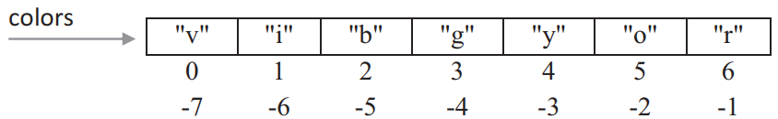
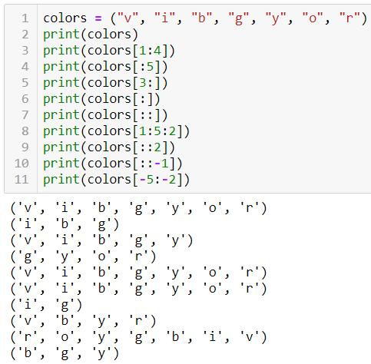
Slicing in tuples

Slide 11
>>> colors = ("v", "i", "b", "g", "y", "o", "r")
>>> colors[1:4]
>>> colors[:5]
>>> colors[3:]
>>> colors[::]
>>> colors[:]
>>> colors[1:5:2]
>>> colors[::-1]
>>> colors[-5:-2]

Slide 12
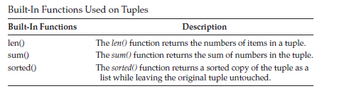
Built-In Functions Used on Tuples
For example,
>>> years = (1987, 1985, 1981, 1996)
>>> len(years)
>>> sum(years)
>>> sorted_years = sorted(years)
>>> sorted_years

Slide 13
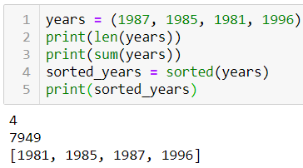
Built-in functions Used on Tuples

Slide 14
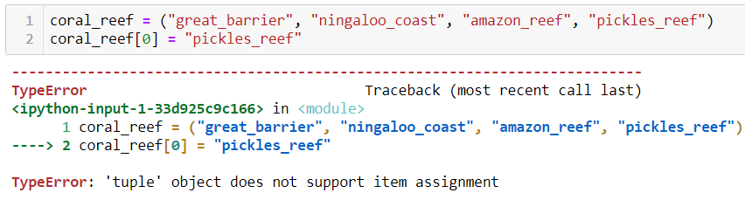
Relation between Tuples and Lists
Though tuples may seem similar to lists, they are often used in different situations and for different purposes.
Tuples are immutable, and usually, contain a heterogeneous sequence of elements that are accessed via unpacking or indexing.
Lists are mutable, and their items are accessed via indexing.
Items cannot be added, removed or replaced in a tuple.

Slide 15
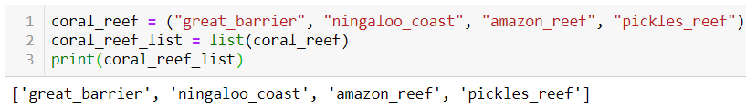
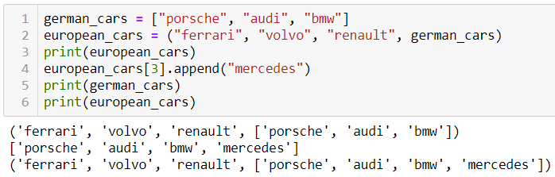
If an item within a tuple is mutable, then you can change it.
Consider the presence of a list as an item in a tuple, then any changes to the list get reflected on the overall items in the tuple.

Slide 16
>>>coral_reef = ("great_barrier", "ningaloo_coast", "amazon_reef", "pickles_reef")
>>> coral_reef[0] = "pickles_reef“
>>>coral_reef_list = list(coral_reef)

Slide 17
If an item within a tuple is mutable, then you can change it. Consider the presence of a list as an item in a tuple, then any changes to the list get reflected on the overall items inthe tuple. For example,
1. >>> german_cars = ["porsche", "audi", "bmw"]
2. >>> european_cars = ("ferrari", "volvo", "renault", german_cars)
3. >>> european_cars
('ferrari', 'volvo', 'renault', ['porsche', 'audi', 'bmw'])
4. >>> european_cars[3].append("mercedes")
5. >>> german_cars
['porsche', 'audi', 'bmw', 'mercedes']
6. >>> european_cars
('ferrari', 'volvo', 'renault', ['porsche', 'audi', 'bmw', 'mercedes'])

Slide 18
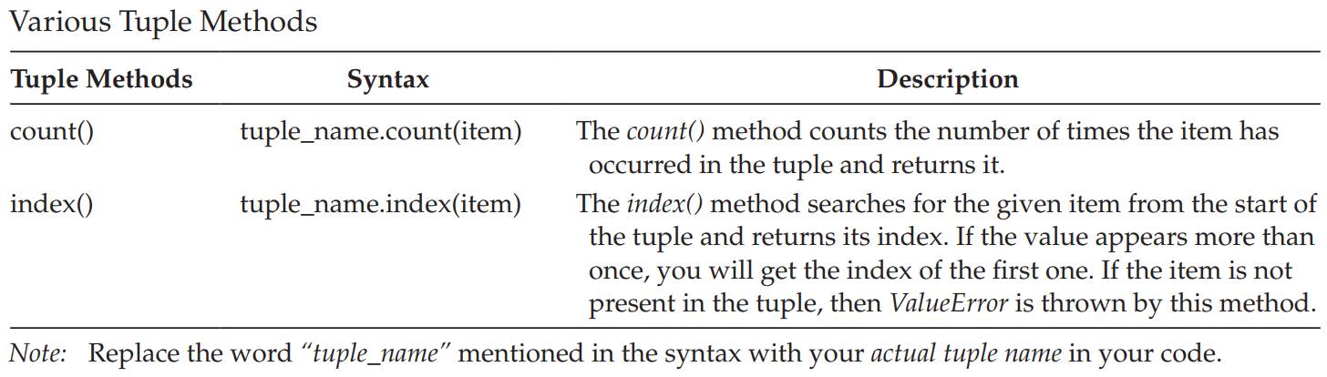
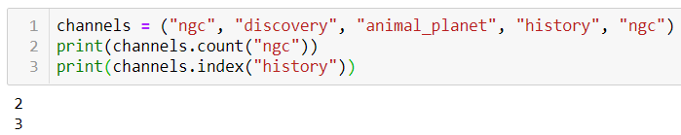
Tuple Methods >>> dir(tuple)

Slide 19

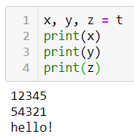
Tuple Packing and Unpacking
The statement t = 12345, 54321, 'hello!' is an example of tuple packing.
The reverse operation of tuple packing is also possible. This operation is called tuple unpacking and works for any sequence on the right-hand side.

Slide 20
Program to Iterate Over Items in Tuples Using for Loop
ocean_animals = ("electric_eel", "jelly_fish", "shrimp", "turtle", "blue_whale")
for i in ocean_animals:
print(f"{i} is an ocean animal")

Slide 21
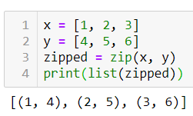
Using zip() Function
The zip() function makes a sequence that aggregates elements from each of the iterables (can be zero or more).
The syntax for zip() function is,
zip(*iterables)
An iterable can be a list, string, or dictionary. It returns a sequence of tuples, where the i-th tuple contains the i-th element from each of the iterables.

Slide 22
>>> x = [1, 2, 3]
>>> y = [4, 5, 6]
>>> zipped = zip(x, y)
>>> list(zipped)
[(1, 4), (2, 5), (3, 6)]
Example 2:
USN=("17EC001","17EC002","17EC003","17EC004")
Name=(“abc",“def",“ijk",“lmn")
USN_Name = list(zip(USN, Name))
print(USN_Name)

Slide 23
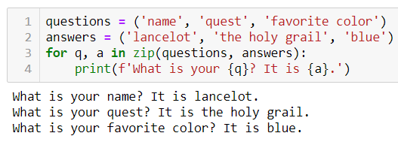
To loop over two or more sequences at the same time, the entries can be paired with the zip() function.

Slide 24
Populating tuples with items
tuple_items = ()
total_items = int(input("Enter the total number of items: "))
for i in range(total_items):
user_input = int(input("Enter a number: "))
tuple_items += (user_input,)
print(f"Items added to tuple are {tuple_items}")
list_items = []
total_items = int(input("Enter the total number of items: "))
for i in range(total_items):
item = input("Enter an item to add: ")
list_items.append(item)
items_of_tuple = tuple(list_items)
print(f"Tuple items are {items_of_tuple}")

Slide 25
Write Python Program to Swap Two Numbers Without Using Intermediate/Temporary Variables. Prompt the User for Input
a = int(input("Enter a value for first number "))
b = int(input("Enter a value for second number "))
b, a = a, b
print("After Swapping")
print(f"Value for first number {a}, Value for second number {b}")

Slide 26
Program to Demonstrate the Return of Multiple Values from a Function
def return_multiple_items():
monument = input("Which is your favorite monument? ")
year = input("When was it constructed? ")
return monument, year
mnt, yr = return_multiple_items()
print(f"My favorite monument is {mnt} and it was constructed in {yr}")
result = return_multiple_items()
print(f"My favorite monument is {result[0]} and it was constructed in {result[1]}")

Slide 27
Write Pythonic Code to Sort a Sequence of Names according to Their Alphabetical Order Without Using sort() Function
def read_list_items():
print("Enter names separated by a space")
list_items = input().split()
return list_items
def sort_item_list(items_in_list):
n = len(items_in_list)
for i in range(n):
for j in range(1, n-i):
if items_in_list[j-1] > items_in_list[j]:
(items_in_list[j-1], items_in_list[j]) = (items_in_list[j], items_in_list[j-1])
print("After Sorting")
print(items_in_list)
all_items = read_list_items()
sort_item_list(all_items)

Slide 28
Sets
Python also includes a data type for sets.
A set is an unordered collection with no duplicate items. Primary uses of sets include membership testing and eliminating duplicate entries. Sets also support mathematical operations, such as union, intersection, difference, and symmetric difference.
Curly braces { } or the set() function can be used to create sets with a comma-separated list of items inside curly brackets { }.

Slide 29
Sets
A set is a collection of unique items. Duplicate items will be removed
Note: to create an empty set you have to use set() and not { } as the latter creates an empty dictionary.
Sets are mutable.
Indexing is not possible in sets, since set items are unordered.
You cannot access or change an item of the set using indexing or slicing.

Slide 30
>>> basket = {'apple', 'orange', 'apple', 'pear', 'orange', 'banana'}
>>> basket
>>> len(basket)
>>> sorted(basket)
>>> 'orange' in basket
>>> 'crabgrass' in basket
>>> a = set('abracadabra')
>>> b = set('alacazam')
>>> a
>>> b
>>> a - b
>>> b-a
>>> a | b
>>> a & b
>>> a ^ b

Slide 31
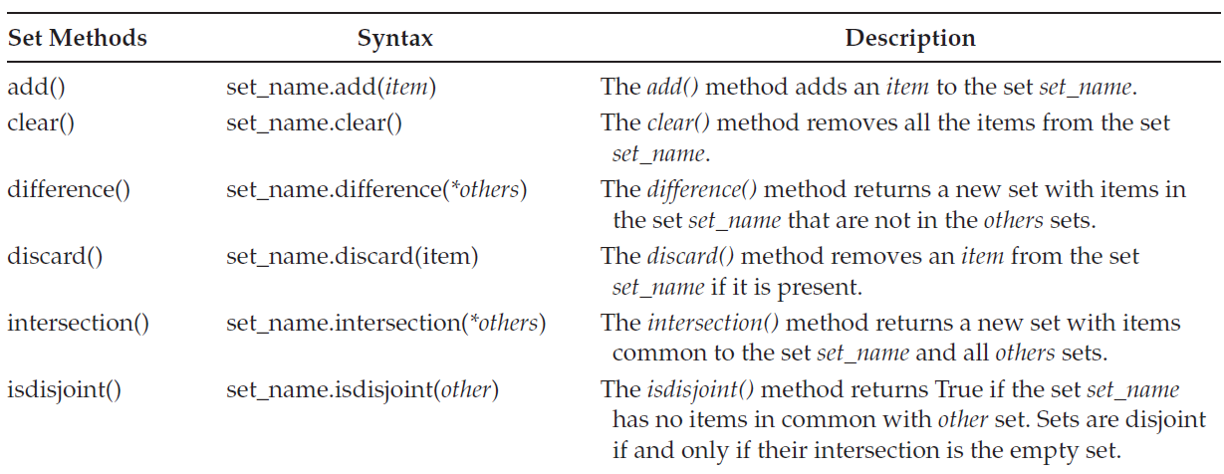
Set Methods >>> dir(set)

Slide 32
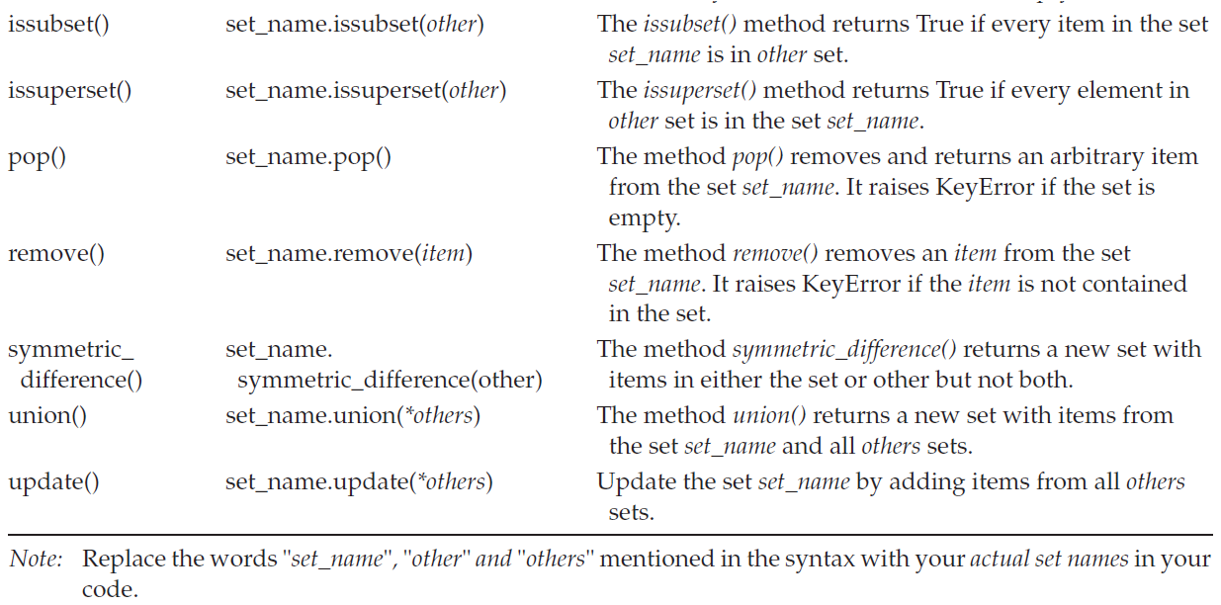

Slide 33
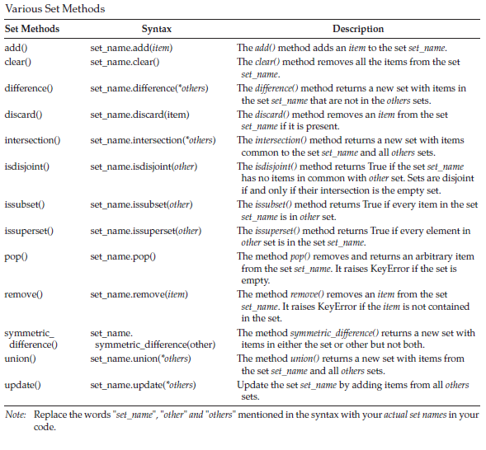

Slide 34
Various Set Methods
>>> european_flowers = {"sunflowers", "roses", "lavender", "tulips", "goldcrest"}
>>> american_flowers = {"roses", "tulips", "lilies", "daisies"}
>>> american_flowers.add("orchids")
>>> american_flowers
>>> american_flowers.difference(european_flowers)
>>> american_flowers-european_flowers
>>> american_flowers.intersection(european_flowers)
>>> american_flowers & european_flowers
>>> american_flowers.isdisjoint(european_flowers)
>>> american_flowers.issuperset(european_flowers)
>>> american_flowers.issubset(european_flowers)

Slide 35
Various Set Methods
>>> american_flowers.symmetric_difference(european_flowers)
>>> american_flowers ^ european_flowers
>>> american_flowers.union(european_flowers)
>>> american_flowers | european_flowers
>>> american_flowers.update(european_flowers)
>>> american_flowers
>>> american_flowers.discard("roses")
>>> american_flowers
>>> european_flowers.pop()
>>> american_flowers.clear()
>>> american_flowers

Slide 36
Traversing of Sets
Program to Iterate Over Items in Sets Using for Loop
warships = {"u.s.s._arizona", "hms_beagle", "ins_airavat", "ins_hetz"}
for i in warships:
print(f"{i} is a Warship")

Slide 37
Write a Function Which Receives a Variable Number of Strings as Arguments. Find Unique Characters in Each String
def find_unique(*all_words):
for i in all_words:
unique_list = list(set(i))
print(f"Unique characters in the word {i} are {unique_list}")
find_unique("egg", "immune", "feed", "vacuum", "goddessship")

Slide 38
Write a Python Program That Accepts a Sentence as Input and Removes All Duplicate Words. Print the Sorted Words
sentence = input("Enter a sentence ")
words = sentence.split()
print(f"The unique and sorted words are {sorted(list(set(words)))}")

Slide 39
Frozenset
A frozenset is basically the same as a set, except that it is immutable.
Once a frozenset is created, then its items cannot be changed. Since they are immutable, they can be used as members in other sets and as dictionary keys.
The frozensets have the same functions as normal sets, except none of the functions that change the contents (update, remove, pop,etc.) are available.
>>> dir(frozenset)

Slide 40
>>> fs = frozenset(["g", "o", "o", "d"])
>>> fs
>>> animals = set([fs, "cattle", "horse"])
>>> animals
>>> official_languages_world = {"english":59, "french":29, "spanish":21}
>>> frozenset(official_languages_world)
>>> frs = frozenset(["german"])
>>> official_languages_world = {"english":59, "french":29, "spanish":21, frs:6}

Slide 41
Summary
Tuple is an immutable data structure comprising of items that are ordered and heterogeneous.
Tuples are formed using commas and not the parenthesis.
Indexing and slicing of items are supported in tuples.
Tuples support built-in functions such as len(), min(), and max().
The set stores a collection of unique values and are not placed in any particular order.
Add an item to the set using add() method and remove an item from the set using the remove() method.
The for loop is used to traverse the items in a set.
The issubset() or issuperset() method is used to test whether a set is a superset or a
subset of another set.
Sets also provide functions such as union(), intersection(), difference(), and symmetric_difference().

Slide 42
Dictionaries
Creating Dictionary
Accessing and Modifying key : value Pairs in Dictionaries
Built-In Functions Used on Dictionaries
Dictionary Methods
The del Statement,

Slide 43
Creating Dictionary
A dictionary is a collection of an unordered set of key:value pairs, with the requirement that the keys are unique within a dictionary.
Dictionaries are constructed using curly braces { }, wherein you include a list of key:value pairs separated by commas.
Also, there is a colon (:) separating each of these key and value pairs, where the words to the left of the colon operator are the keys and the words to the right of the colon operator are the values.
Unlike lists, which are indexed by a range of numbers, dictionaries are indexed by keys.
Here a key along with its associated value is called a key:value pair.
Dictionary keys are case sensitive.

Slide 44
Dictionary keys are immutable type and can be either a string or a
number.
Since lists can be modified in place using index assignments,
slice assignments, or methods like append() and extend(), you cannot
use lists as keys. Duplicate keys are not allowed in the dictionary.

Slide 45
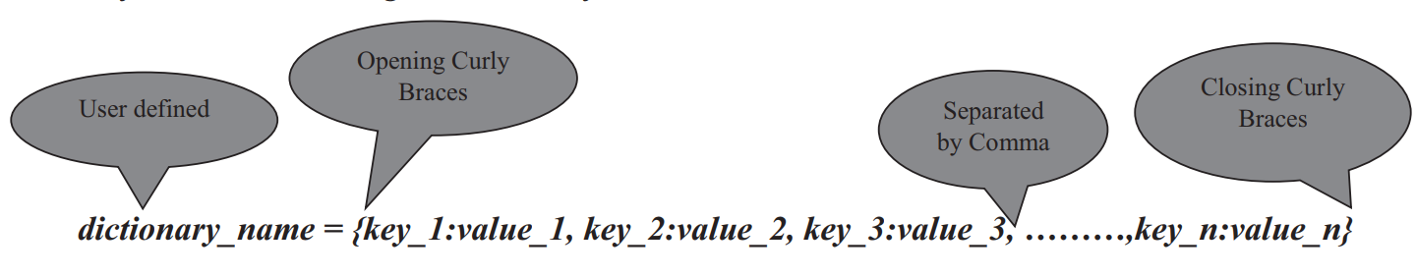
Creating dictionaries
The syntax for creating a dictionary is
fish = {"g": "goldfish", "s":"shark", "n": "needlefish", "b":"barramundi","m":"mackerel"}

Slide 46
Dictionaries and their associated values
>>> mixed_dict = {"portable":"laptop", 9:11, 7:"julius"}
>>> mixed_dict
{'portable': 'laptop', 9: 11, 7: 'julius'}
>>> type(mixed_dict)
<class 'dict'>
Creating empty dictionaries:
>>> empty_dictionary = {}
>>> type(empty_dictionary)
<class 'dict'>

Slide 47
>>> pizza = {"pepperoni":3, "calzone":5, "margherita":4}
>>> fav_pizza = {"margherita":4, "pepperoni":3, "calzone":5}
>>> pizza == fav_pizza

Slide 48
Accessing and Modifying key:value Pairs in Dictionaries
The syntax for accessing the value for a key in the dictionary is,
dictionary_name[key]
The syntax for modifying the value of an existing key or for adding a new key:value pair to a dictionary is,
dictionary_name[key] = value
If the key is already present in the dictionary, then the key gets updated with the new value.
If the key is not present then the new key:value pair gets added to the dictionary.

Slide 49
Adding and Modifying key:value pairs
>>> renaissance = {"giotto":1305, "donatello":1440, "michelangelo":1511,"botticelli":1480, "clouet":1520}
>>> renaissance["giotto"] = 1310
>>> renaissance
>>> renaissance["leonardo"]
Traceback (most recent call last):
File "<pyshell#13>", line 1, in <module> renaissance["leonardo"]
KeyError: 'leonardo'
>>> renaissance["michelangelo"]
>>> renaissance["leonardo"] = 1503
>>> renaissance
{'giotto': 1310, 'donatello': 1440, 'michelangelo': 1511, 'botticelli': 1480, 'clouet': 1520, 'leonardo': 1503}

Slide 50
Check for the presence of a key in the dictionary
You can check for the presence of a key in the dictionary using in and not in membership operators.
It returns either a Boolean True or False value.
>>> clothes = {"rainy":"raincoats", "summer":"tees", "winter":"sweaters"}
>>> "spring" in clothes
>>> "spring" not in clothes

Slide 51
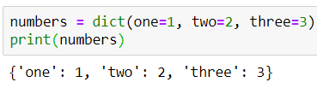
The dict() Function
The built-in dict() function is used to create dictionary.
The syntax for dict() function when the optional keyword arguments used is,
dict([**kwarg])
The syntax for dict() function when iterables used is,
dict(iterable[, **kwarg])
You can specify an iterable containing exactly two objects as tuple, the key and value in the dict() function.
>>>dict([('sape', 4139), ('guido', 4127), ('jack', 4098)])

Slide 52
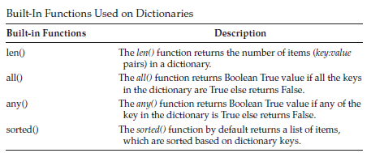
Built-in functions used on dictionaries
In Python, any non-zero integer value is True, and zero is interpreted as False.
The sorted() function returns the sorted list of keys by default in ascending order without modifying the original key:value pairs

Slide 53
>>> presidents = {"washington":1732, "jefferson":1751, "lincoln":1809, "roosevelt":1858, "eisenhower":1890}
>>> len(presidents)
>>> sorted(presidents)
>>> sorted(presidents, reverse = True)
>>> sorted(presidents.values())
>>> sorted(presidents.items())

Slide 54
>>> dict_func1 = {0:True, 2:False}
>>> all(dict_func)
>>> dict_func2 = {1:True, 2:False}
>>> all(dict_func2)
>>> any(dict_func)
>>> dict_func3 = {0:True, 0:False}
>>> any(dict_func3)

Slide 55
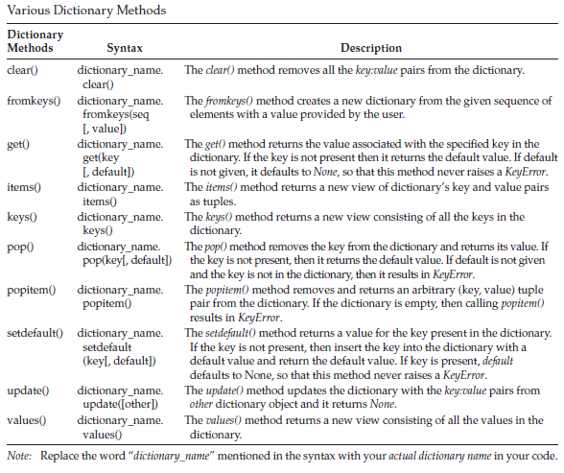
Dictionary Methods- >>> dir(dict)

Slide 56
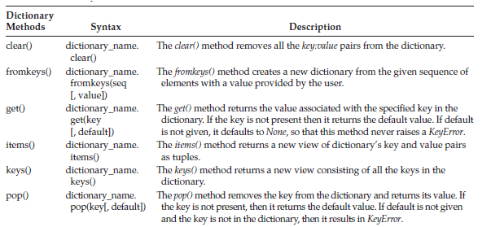
Dictionary Methods- >>> dir(dict)

Slide 57
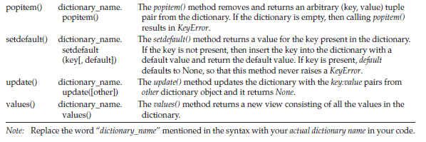
Dictionary Methods- >>> dir(dict)

Slide 58
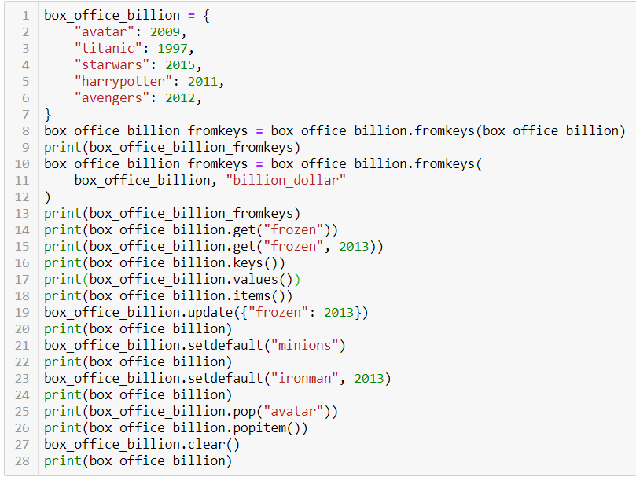
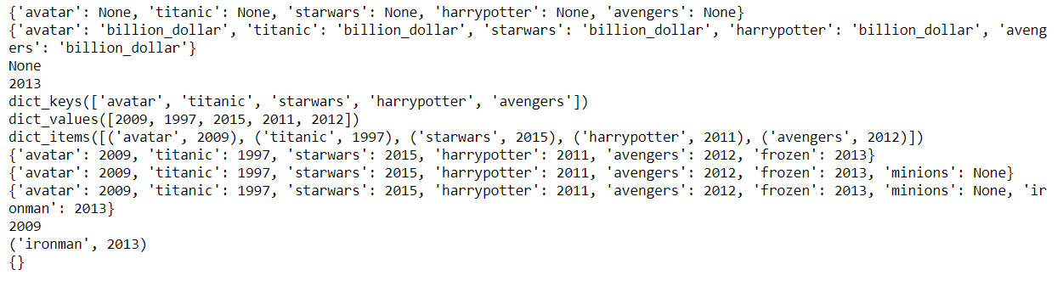
Dictionary Methods

Slide 59
>>>box_office_billion = {"avatar":2009, "titanic":1997, "starwars":2015, "harrypotter":2011, "avengers":2012}
>>>>>>id(boxbox_office_billion_fromkeys = box_office_billion.fromkeys(box_office_billion)
_office_billion )
>>>id(box_office_billion_fromkeys)
>>>box_office_billion_fromkeys = box_office_billion.fromkeys(box_office_billion, "billion_dollar")
>>> box_office_billion.keys()
>>> box_office_billion.values()
>>> box_office_billion.items()
>>> box_office_billion.update({"frozen":2013})
>>> box_office_billion.setdefault("minions")
>>> box_office_billion.setdefault("ironman", 2013)
>>> box_office_billion.pop("avatar")
>>> box_office_billion.popitem()
>>> box_office_billion.clear()

Slide 60
>>> print(box_office_billion.get("frozen"))
>>> box_office_billion.get("frozen",2013)
>>> box_office_billion.get("avatar")
>>> box_office_billion.get("avs")
>>> box_office_billion.get("avs", "Not Found")
>>>box_office_billion.get("avatar", "Not Found")
>>>studs={"ec101":"ab", "ec102":“hs", "B_sec":['ajay','abhishek','amar','atish'], 'ECE':{"6A":‘Raj',"6B":‘Ram',"6C":‘Bheem', "6D":'sham'}}
>>> studs['ec102']
>>> studs['B_sec']
>>> studs['ECE']
>>> keys=[10,20,30,40]
>>> values=['BSc','BCom','Arts','MassCom']
>>> degrees=zip(keys,values)
>>> degrees=dict(zip(keys,values))
>>> degrees
>>> del degrees[10]

Slide 61
If you want to convert dict_keys, dict_values, and dict_items data types returned from keys(), values(), and items() methods to a true list then pass their list, such as returned values, to list() function
>>>list(box_office_billion.keys())
>>> list(box_office_billion.values())
>>> list(box_office_billion.items())

Slide 62
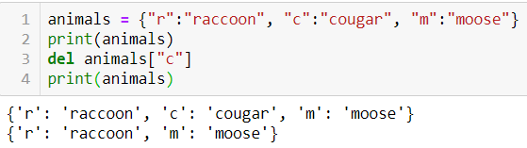
The del Statement
To delete the key:value pair, use the del statement followed by the name of the dictionary along with the key you want to delete.
del dict_name[key]

Slide 63
Write Python Program to Generate a Dictionary That Contains (i: i*i) Such that i Is a Number Ranging from 1 to n.
number = int(input("Enter a number "))
create_number_dict = dict()
for i in range(1, number+1):
create_number_dict[i] = i * i
print("The generated dictionary of the form (i: i*i) is")
print(create_number_dict)

Slide 64
#Program to Dynamically Build User Input as a List #Method 1
print("Method 1: Building Dictionaries")
build_dictionary = {}
for i in range(0, 2):
dic_key = input("Enter key ")
dic_val = input("Enter val ")
build_dictionary.update({dic_key: dic_val})
print(f"Dictionary is {build_dictionary}")

Slide 65
#Program to Dynamically Build User Input as a List #Method 2
print("Method 2: Building Dictionaries")
build_dictionary = {}
for i in range(0, 2):
dic_key = input("Enter key ")
dic_val = input("Enter val ")
build_dictionary[dic_key] = dic_val
print(f"Dictionary is {build_dictionary}")

Slide 66
#Program to Dynamically Build User Input as a List #Method 3
print("Method 3: Building Dictionaries")
build_dictionary = {}
i = 0
while i < 2:
dict_key = input("Enter key ")
dict_val = input("Enter val ")
build_dictionary.update({dict_key: dict_val})
i = i + 1
print(f"Dictionary is {build_dictionary}")

Slide 67
Write a Python Program to Input Information for n number of Students as Given Below: a. Name b. Registration Number c. Total Marks. The user has to specify a value for n number of students. The Program Should Output the Registration Number and Marks of a Specified Student Given His Name
def student_details(number_of_students):
student_name = {}
for i in range(0, number_of_students):
name = input("Enter the Name of the Student ")
registration_number = input("Enter student's Registration Number ")
total_marks = input("Enter student's Total Marks ")
student_name[name] = [registration_number, total_marks]
student_search = input('Enter name of the student you want to search ')
if student_search not in student_name.keys():
print('Student you are searching is not present in the class')
else:
print("Student you are searching is present in the class")
print(f"Student's Registration Number is {student_name[student_search][0]}")
print(f"Student's Total Marks is {student_name[student_search][1]}")
number_of_students = int(input("Enter the number of students "))
student_details(number_of_students)

Slide 68
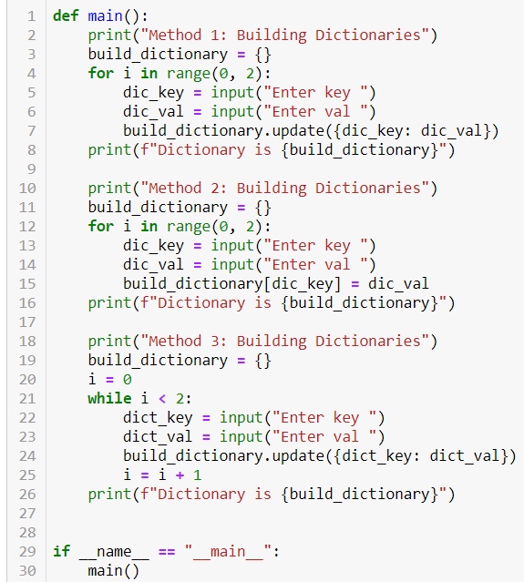
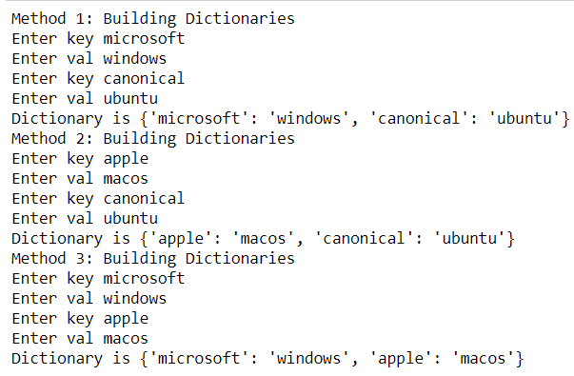
Program to Dynamically Build User Input as a List

Slide 69
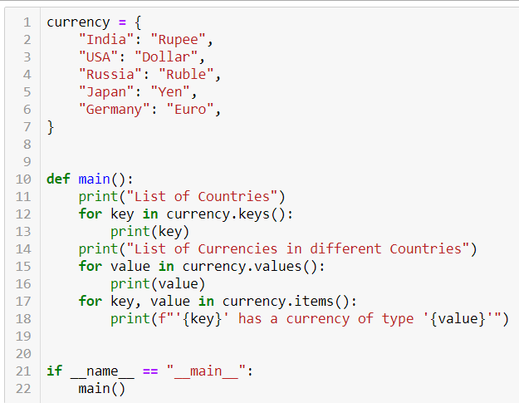
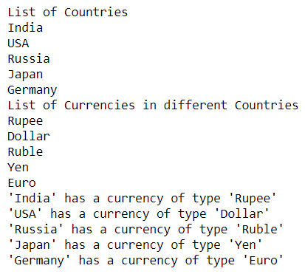
Program to Illustrate Traversing of key:value Pairs in Dictionaries Using for Loop

Slide 70
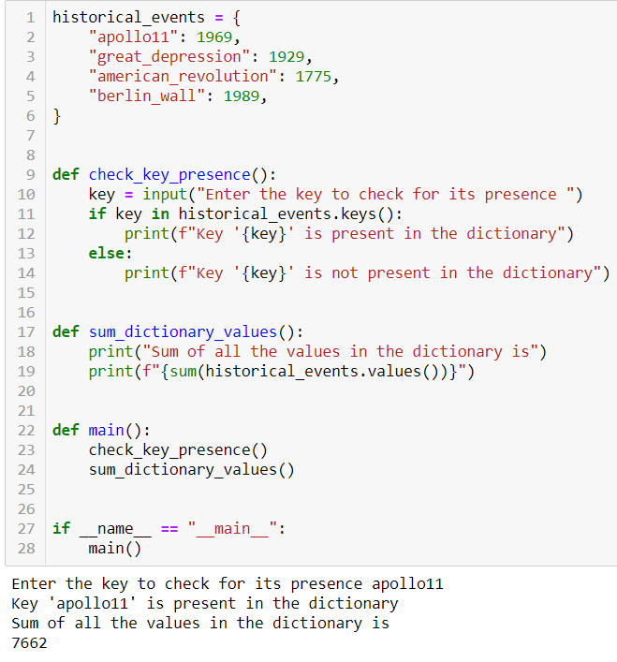
Write Python Program to Check for the Presence of a Key in the Dictionary and to Sum All Its Values

Slide 71
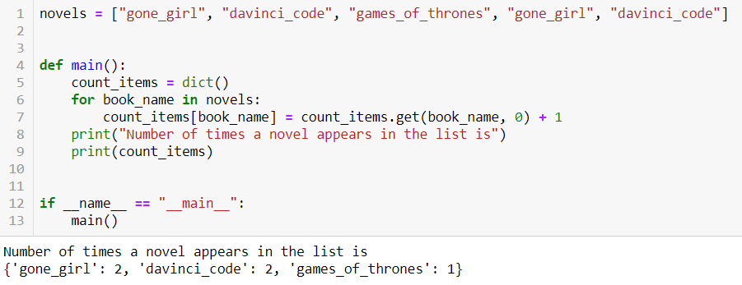
Write Python Program to Count the Number of Times an Item Appears in the List

Slide 72
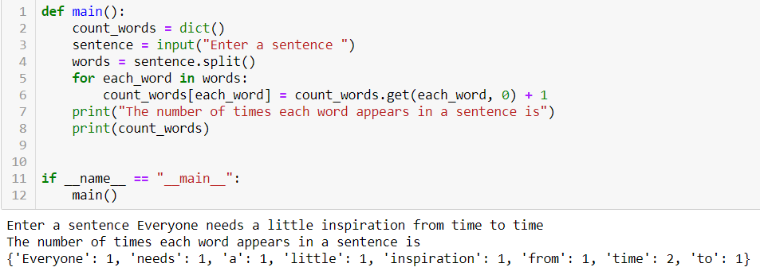
Write Python Program to Count the Number of Times Each Word Appears in a Sentence

Slide 73
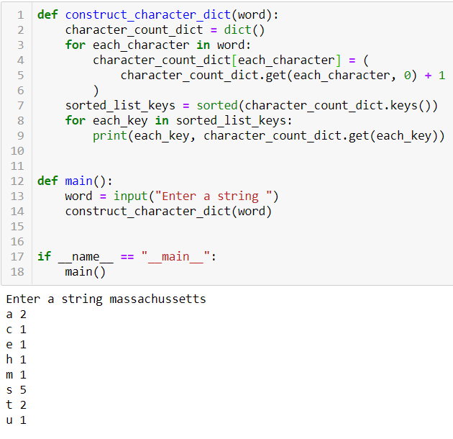
Write Python Program to Count the Number of Characters in a String Using Dictionaries. Display the Keys and Their Values in Alphabetical Order.
a

Slide 74
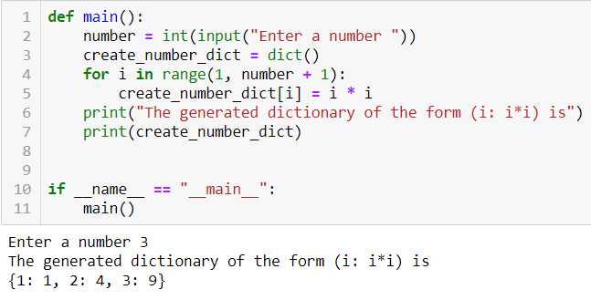
Write Python Program to Generate a Dictionary That Contains (i: i*i) Such that i Is a Number Ranging from 1 to n

Slide 75
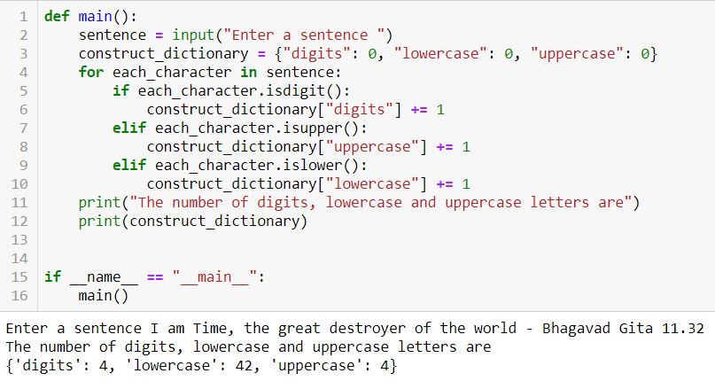
Write a Program That Accepts a Sentence and Calculate the Number of Digits, Uppercase and Lowercase Letters.
a

Slide 76
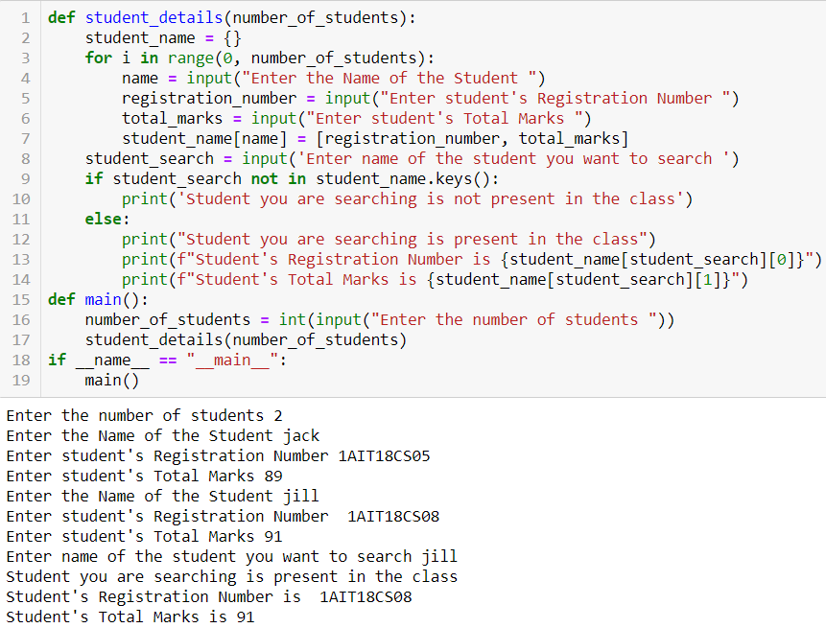
Write a Python Program to Input Information for n number of Students as Given Below: a. Name b. Registration Number c. Total Marks The user has to specify a value for n number of students. The Program Should Output the Registration Number and Marks of a Specified Student Given His Name
a

Slide 77
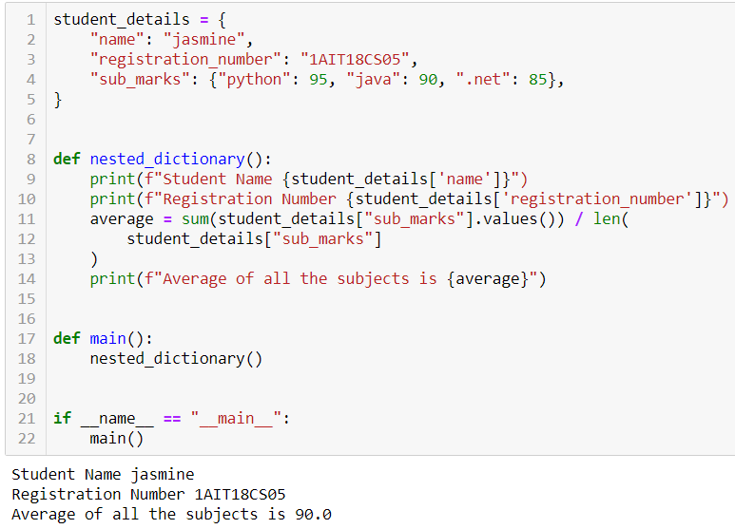
Program to Demonstrate Nested Dictionaries

